Slide 1
Water Project
Mechanical design

Slide 2
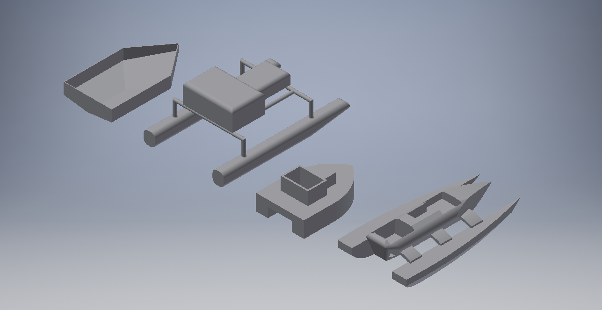
4 ideas of the shape of the boat

Slide 3
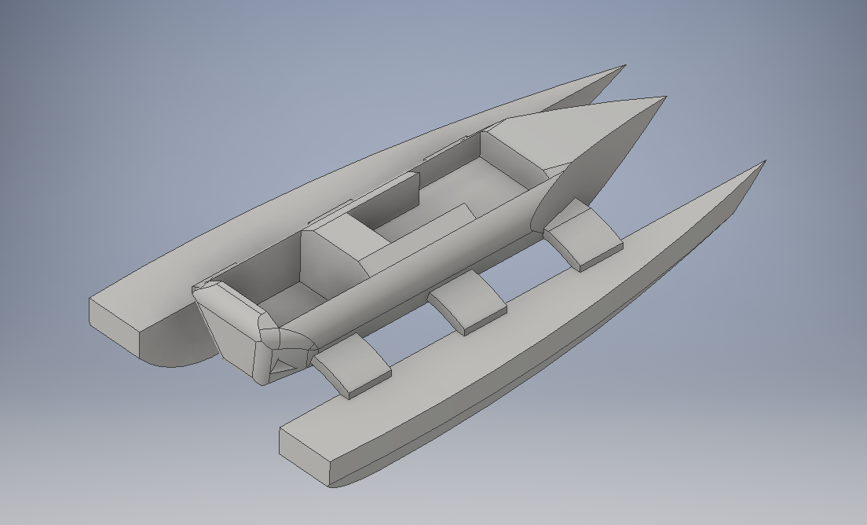
Selected shape
Reason:
The main body of the boat is above the water level, thus it has lesser problem on water leakage.
The shape of the boat is more streamline, thus reduce the water drag.

Slide 4
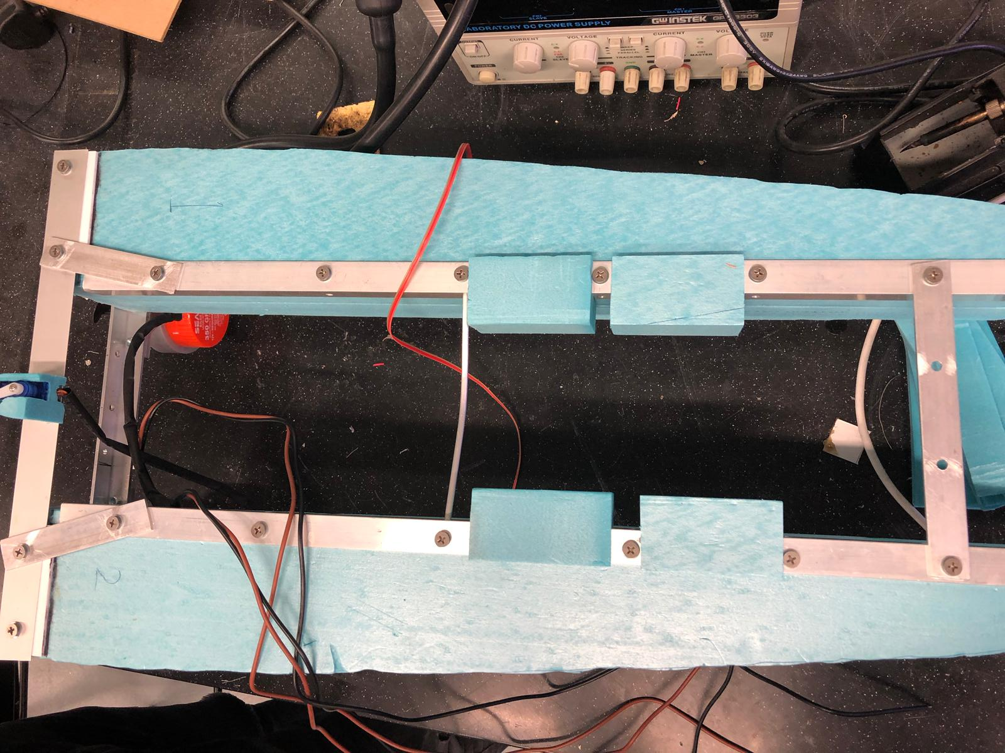
Mechanical Design
Use blue Styrofoam as the floating material.
Low density
Easy to craft the shape
Harder and stronger as compare to white Styrofoam.
Waterproof
Use aluminium as the support structure to carry the weight.
Relatively low density as compare to other metal.
Easy to access.

Slide 5
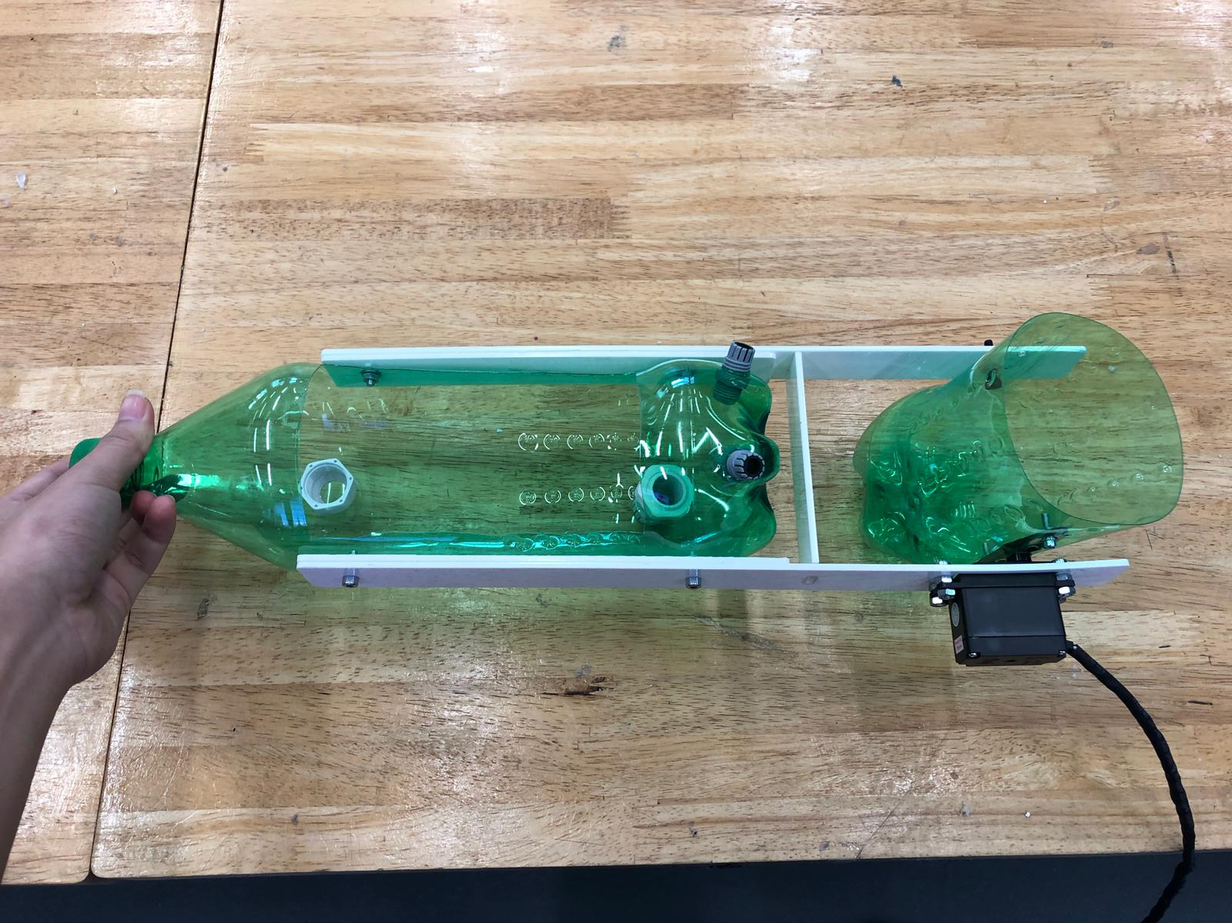
Mechanical Design
Use 1.5little bottle for the body of the boat.
Easy to make it waterproof
Easy to get (recycle material)

Slide 6
Calculations:
Volume of the base material: 8245481.523mm^3 ( from inventor )
Estimate of the actual volume of the base material: 7500000mm^3= 0.0075m^3
Mass of the load it can carry: 0.0075m^3x997kg/m^3=7.4kg
Mass of the whole boat: 1.815kg
Mass of fish bait it can carry: 7.4kg-1.815kg=5.585kg
Set the safety factor as 2: 5.585kg/2=2.8kg
Thus, it can carry 2.8kg of fish bait.

Slide 7
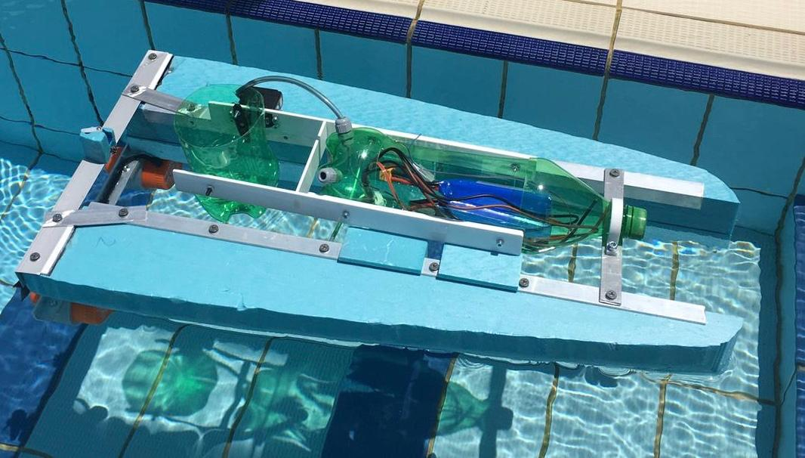
Waterproof design
The main body which contain all the electronics are above water level, this reduce the water leakage effect on the body.
The bottle is also fully sealed to prevent water from going into the body.

Slide 8
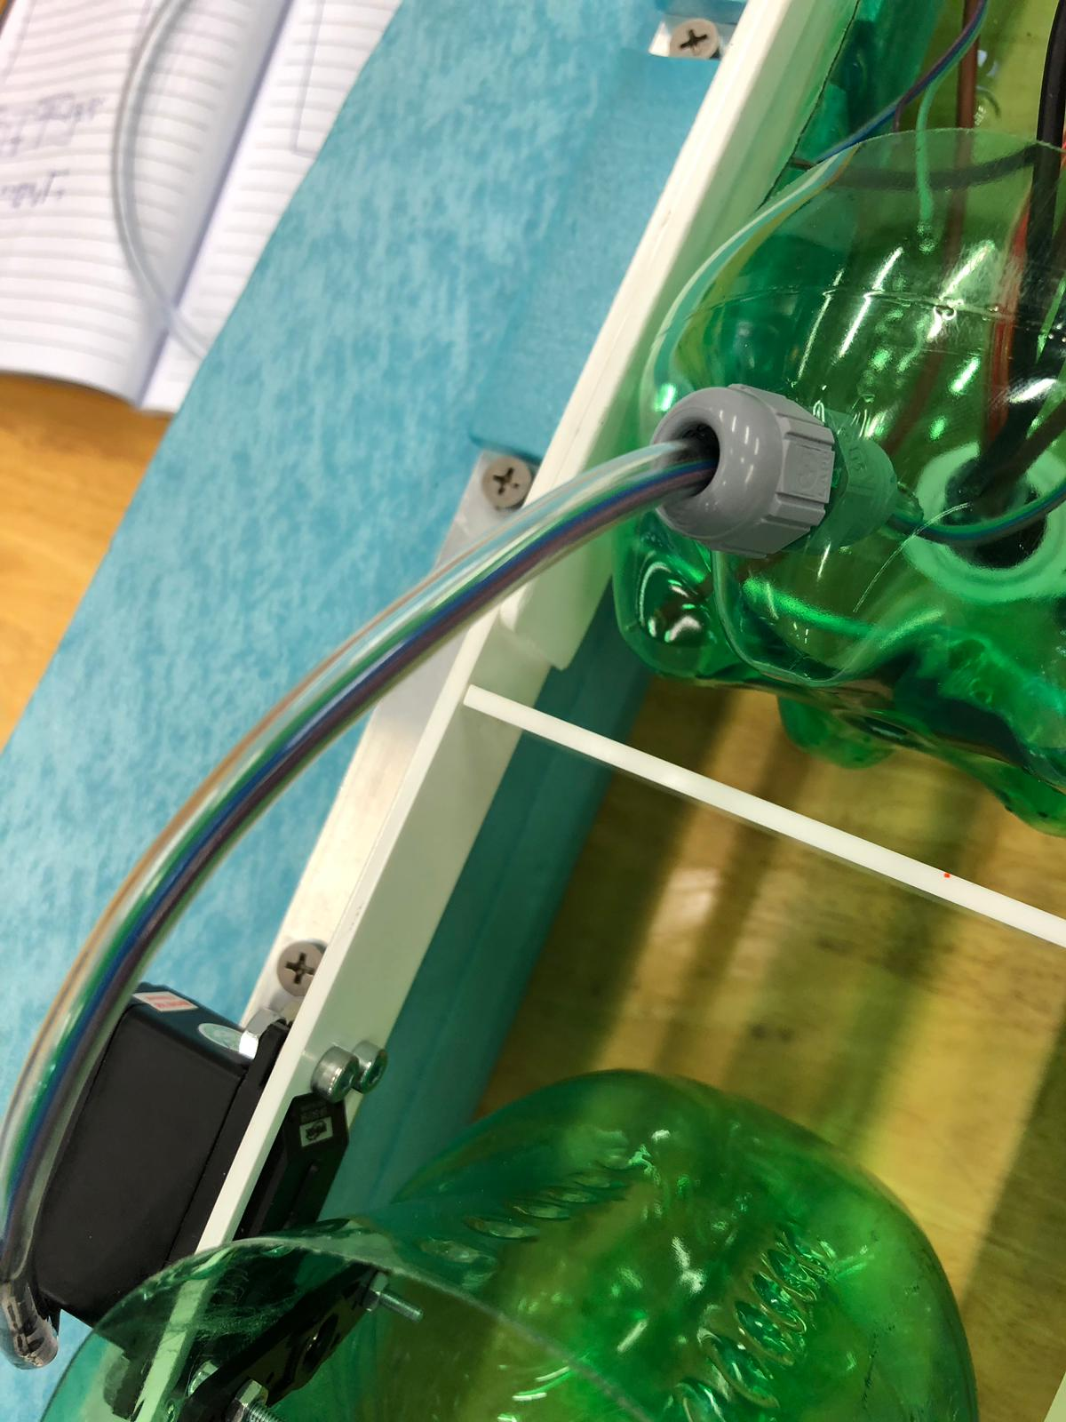
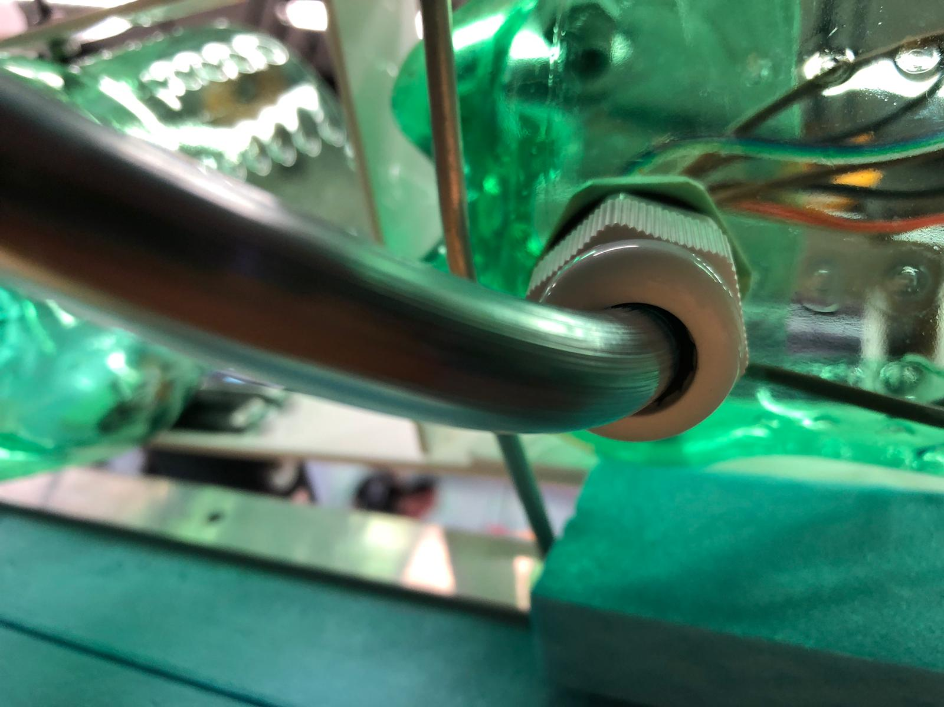
Waterproof design
Use of tubing and cable gland for all the wires that is outside of the main body to prevent water linkage.

